Slide 1

ML 101 Course
Arush Garg
AI and Machine Learning Club
Overseas Family School

Slide 2

Course (bit.ly/ML_101)
Introduction to Machine Learning (ML)
Regression
Core ML Concepts
Classification
Decision Trees
Model selection and tuning
Unstructured data: Text
Neural Networks
Unstructured data: Images
Introduction to Deep Learning
Beyond Regression & Classification
Notes:
Welcome back to ML 101 course. In today’s lesson we will learn about another supervised learning method called Decision Trees.

Slide 3
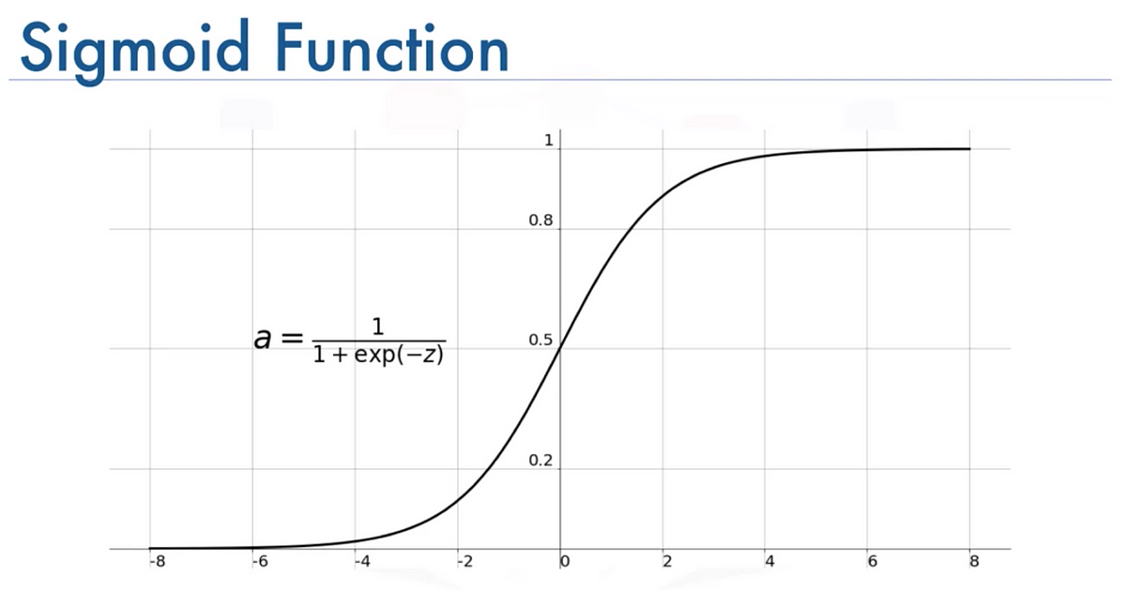
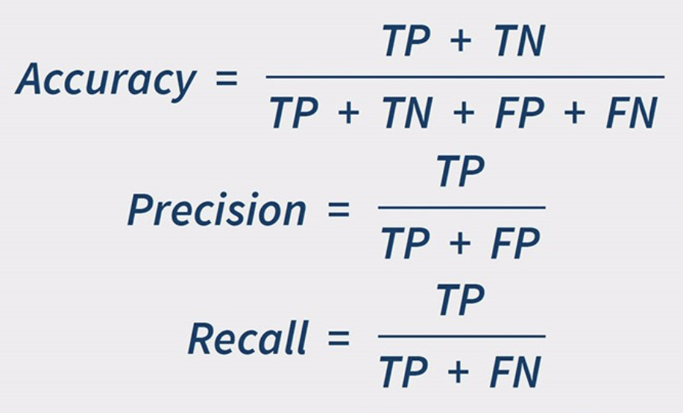
Recap
Supervised Learning
Regression: Predicted value is a “continuous numerical value”
Classification: Predict “yes / no” (binary) or “one of multiple choices” (multi-class)
Core ML Concepts
Cost functions and Gradient Descent Algorithm
Data Sampling & Cleaning
Handling categorical values using One-Hot Encoding
Logistic Regression
Binary classifier. Apply Sigmoid activation function to Linear Regression equation
Cost function = Log-Loss or Cross-Entropy Loss
Precision: How often when model predicts “Yes”, it is actually “Yes”
Recall: Of all actual “Yes” cases, what %age model identified correctly?
Accuracy: How often model makes is correct across all predictions
In case of Logistic Regression,
z = Linear Regression equation
Notes:
So far we have learnt about the two types of Supervised Learning problems: Regression where we predict a value and Classification where we predict a class
We also covered some of the common ML concepts like “cost functions”, “evaluation metrics” and how to handle dirty or missing data as well as how to handle categorical features using one-hot encoding
(click)
In the last class we learnt about Logistic Regression method that is used for binary classification. The most commonly used metrics to evaluate the quality of a classifier are Precision, Recall and Accuracy

Slide 4
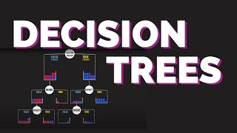
Introduction to Decision Trees
Gini Index
Just like “Information Gain”, “Gini Index” is another measure to decide the decision node.
Gini Index measures the impurity of a node. Therefore lower the Gini Index, better it is.
Econoscent on YouTube [link]
Notes:
So far we have learnt about Linear models: Linear Regression and Logistic Regression. In both cases we combine the input features using a linear equation.
As you will see in this video, Decision Tree is a non-linear model and takes a very different approach.
(click to play video)
(click after video)
Gini Index is another measure that is similar to “Information Gain” that helps decide the decision nodes while optimizing for the “purity” of the leaf nodes.

Slide 5
Decision Tree
Decision Tree is like a sequence of nested if-else conditions
That’s why it is very easy to understand & explain model predictions (high explainability)
Lowest level (leaf nodes) contain the final prediction
“Class” in case of Classification: majority class prob. based on all the training data points that belonged to the leaf node
“Value” in case of Regression: avg. of all training data points that belonged to the leaf node
Decision Trees can use categorical features as-is. There is no need to do one-hot-encoding
To avoid overfitting in Decision Trees:
Control the “depth / height” of the decision tree. If the tree grows too tall, it might end up overfitting the training data
Control the “minimum number of training samples” at the leaf node. Too few samples might lead to over-fitting
Notes:
As we saw in the video, the decision trees are a sequence of nested if-else conditions and hence they are very easy to understand and explain.
(click)
The leaf nodes guide the final prediction. In case of “classification problem” the probability of the class is calculated based on the training data point that belong to the lead node. That why pure nodes are preferred as probability will be either closer to 0 or closer to 1.
Decision Trees can also be used for regression problems, there is a video link in the further reading slide related to that.
(click)
Decision trees can use the categorical features as-is. E.g. you can imagine decision nodes to be something like “Color = ‘Red’” or “Shape = ‘Triangle’”. Hence no need for one-hot-encoding.
(click)
And to avoid overfitting in Decision Trees, one should control the “depth” of the tree as well as “minimum number of training samples” at the leaf node.

Slide 6

Decision Tree Ensemble Methods: Random Forest
Collection of Decision Trees
Trees trained parallely
Each tree skips a few random features (cols)
Each tree skips a few random rows (samples)
Final prediction:
Classification: Vote
Regression: Avg
Econoscent on YouTube [link]
Notes:
As we don’t want a Decision Tree to be very tall, a single decision tree might not be able to do a good job in many scenarios.
In this video we will learn about another model called Random Forest that is an ensemble of Decision Trees.
(click to play video)
(click - after video)
Random forest is a collection of decision tree. Each tree is trained with a slightly different training data hence each decision tree is expected to be different.
Idea here is combine a group of “weak learners” to make a single “strong learner”.

Slide 7
Other popular ML methods for Supervised Learning
Other Decision Tree Ensembles
Gradient Boosted Tree (very popular, multiple versions like XGBoost, CatBoost)
Adaptive Boosting (AdaBoost)
Naive Bayes
Support Vector Machines (SVM)
K-Nearest Neighbors (KNN)
Neural Networks
Notes:
There are many other popular ML methods for Supervised Learning
In this course we will cover KNN and Neural Networks. You can find video links to learn about some of the other popular models in the “further reading” slide.

Slide 8
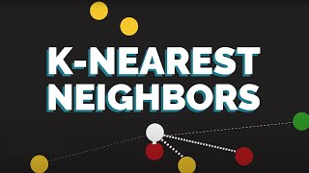
KNN: K-Nearest Neighbors
No learning involved. That way, it’s NOT an ML model
Prediction based on nearest neighbors in training data
For “distance computation” features need to be numeric.
Feature scaling is crucial.
Can be used for Classification & Regression
Model size might be a concern if training set is big
Often a good starting point to establish a baseline
Econoscent on YouTube [link]
Notes:
KNN is one of the simplest supervised learning model, actually there is no “learning” involved
(click to play video)
(click - after the video ends)
As you saw, KNN simply depends on making a prediction based on the K nearest data points in the training data. Though it is a very simple model, do not underestimate it as it might actually be a very useful model in many circumstances.

Slide 9
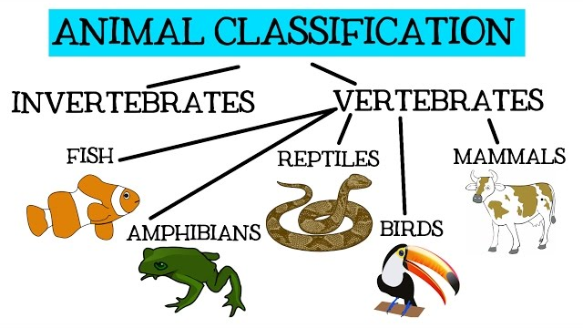
Hands-on Exercises
Lesson 5 / DTree_Animal.ipynb
https://bit.ly/ML_101
Notes:
This week’s exercise looks at classifying an animal into 1 of 7 categories, the same data set we looked at last lesson. We will also visualise the decision tree trained at the end.

Slide 10

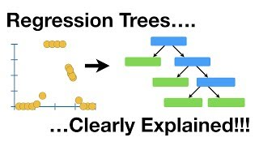
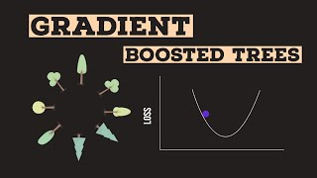
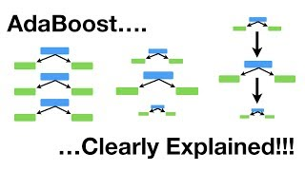

Further Reading / Watching / Doing
How to use Decision Tree for Regression problems
DTree_Titanic.ipynb
OtherClassifiers_Titanic.ipynb
https://bit.ly/ML_101
StatQuest with Josh Starmer
Econoscent
StatQuest with Josh Starmer
Visually Explained
Notes:
To practise further with decision trees, check out the problem in this lesson’s problem.md. The problem is the same as last time - Predicting whether someone would survive or die in the Titanic. This problem has also been addressed using Random Forest and KNN in the OtherClassifiers_Titanic.ipynb file.
To learn more, watch these videos about regression trees, gradient boosting, ada booting and support vector machines.

Slide 11

Agenda for next class
Model Selection
Cross Validation
Comparing different models
Model Tuning
Hyperparameter tuning
Other practical tips
Notes:
Now that we have seen that there are so many different ML algorithms to choose from, the obvious next question would be “how”. How do we decide which model to choose for a given problem.
This is the question we will attempt to answer in our next class.

